Slide 1


Electric Circuits
Twelfth Edition, Global Edition
Chapter 6 – Part 3
Inductance, Capacitance, and Mutual Inductance
© 2024 Pearson Education Ltd. All Rights Reserved.
Notes:
If this PowerPoint presentation contains mathematical equations, you may need to check that your computer has the following installed:
1) Math Type Plugin
2) Math Player (free versions available)
3) NVDA Reader (free versions available)

Slide 2
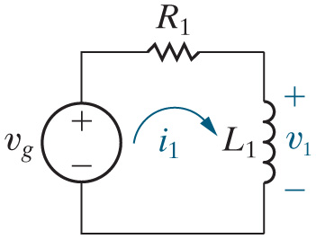
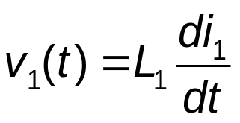



Chapter 6 – Mutual Inductance (1 of 15)
Start with a simple R L circuit with a time-varying voltage source:
Bring in another coil, and continue moving it closer to the first coil – what happens? Eventually , the coils are close enough
that the magnetic field surrounding the
coil also envelops
the
coil, resulting in a voltage drop across the
coil that is proportional to the first derivative of the
current!

Slide 3
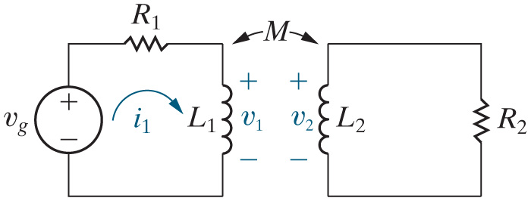
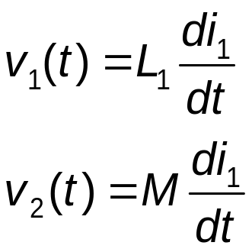





Chapter 6 – Mutual Inductance (2 of 15)
But the voltage drop across the
and the voltage drop across the
resistor) creates current in the
circuit. This current, labeled
induces a time-varying magnetic field in the
coil, causes additional
voltage to drop across the
coil, and, because the
coil is close to the
coil, causes additional voltage drop across the
coil, proportional to
the first derivative of the
current!

Slide 4
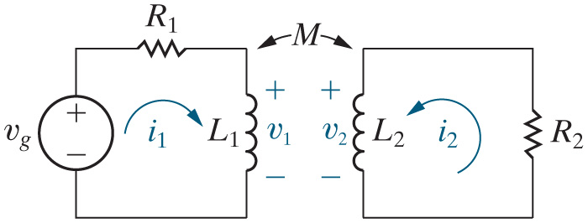
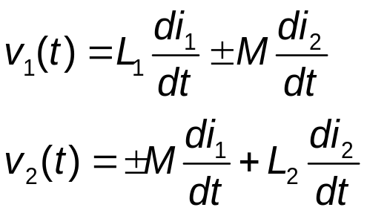


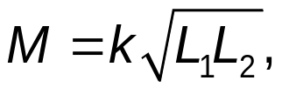

Chapter 6 – Mutual Inductance (3 of 15)
We call
and
the self-inductances of the coils.
We call M the mutual inductance of the coils.
and
and M are related by the following equation:
k is called the coupling coefficient, and is a measure of how much of the magnetic field of one coil envelops the other coil.

Slide 5
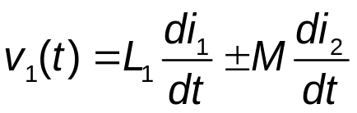
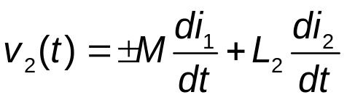
Chapter 6 – Mutual Inductance (4 of 15)
The sign of the self-induced voltage for the two coils is determined by the passive sign convention.
Based on the inductor voltage polarities and current directions shown in the circuit, the two self-induced voltage terms in the above equations are both positive.
The sign of the mutually-induced voltage for the two coils is determined by physical examination of the coils, and is notated on the circuit schematic using dots.
To determine the sign of the mutually-induced voltages for the two coils, use the dot convention.

Slide 6
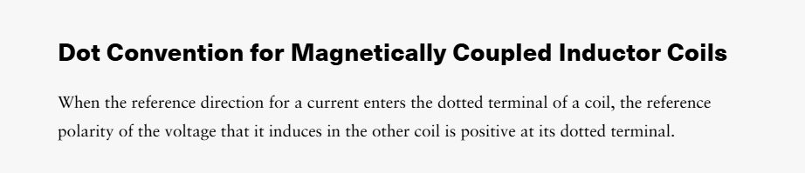
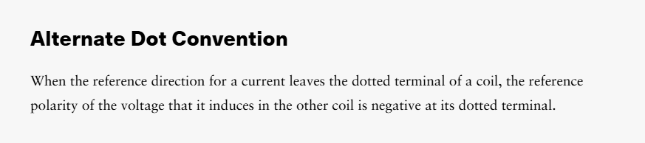
Chapter 6 – Mutual Inductance (5 of 15)
The dot convention for mutually-coupled coils:
When the current enters the dotted (un-dotted) terminal of one coil, the mutually-induced voltage drop is positive at the dotted (un-dotted) terminal of the other coil.

Slide 7
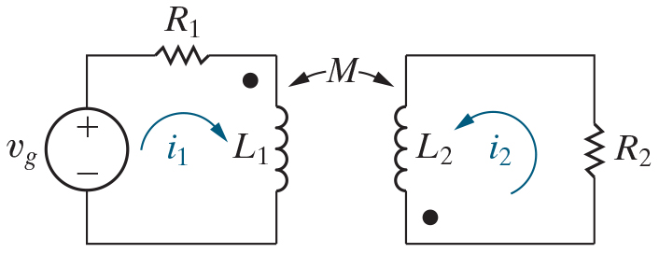
Chapter 6 – Mutual Inductance (6 of 15)
The mesh current method (K V L) is always used to analyze circuits with mutually-coupled coils. Follow these steps:
Draw the mesh currents and label them.
Pick a location on the left mesh and sum the voltage drops around the mesh in the direction of the mesh current, using the passive sign convention for the self-induced voltage terms.
Put the mutually-induced voltage term in the mesh equation, but don’t include its sign yet.
Now look at the current in the right mesh – if it enters the dot (un-dot), the mutually-induced voltage term is positive at the dot (un-dot) of the other coil. Put a small + at the dot (un-dot).
If the current in the left mesh points at the + you just drew, the mutually-induced voltage term in the equation has a + sign; otherwise, it has a − sign.
Repeat steps 2 – 5 for the right mesh!

Slide 8
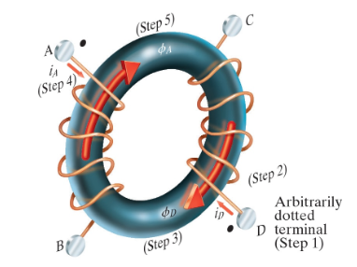
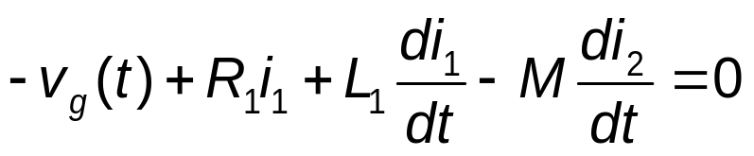
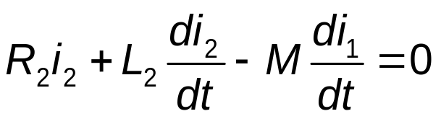
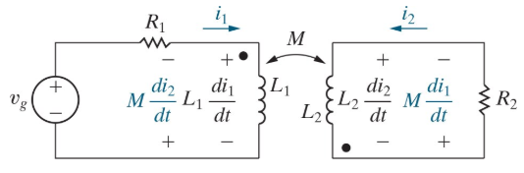
Chapter 6 – Mutual Inductance (7 of 15)
Write the mesh-current (K V L) equations for the two coils shown here:
Notes:
Long Description:
Negative v subscript g BaseLine Open Parenthesis t Close Parenthesis plus R subscript 1 BaseLine i subscript 1 BaseLine plus L subscript 1 BaseLine Start Fraction d i subscript 1 BaseLine over d t End Fraction minus M Start Fraction d i subscript 2 BaseLine over d t End Fraction equals 0.

Slide 9
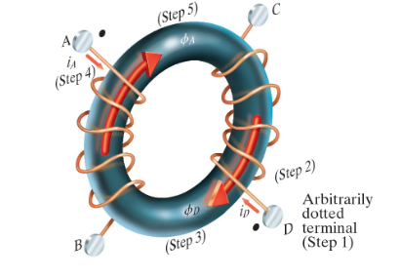
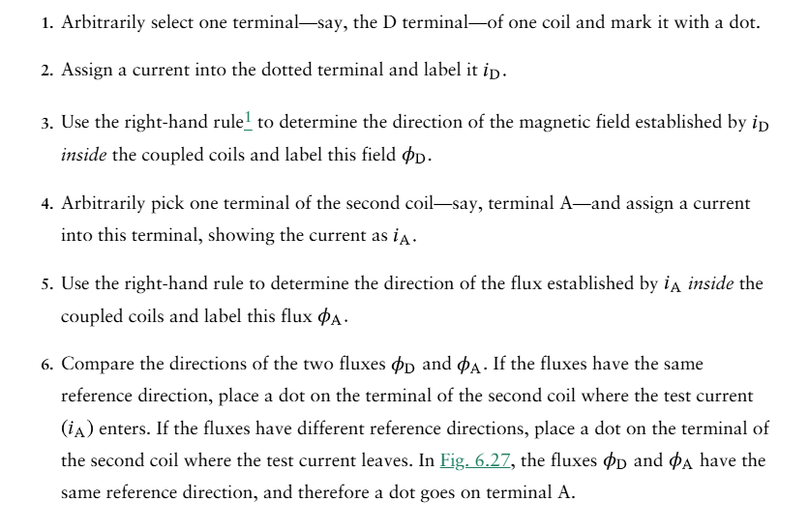

Slide 10
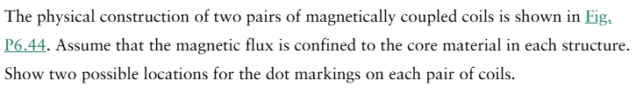
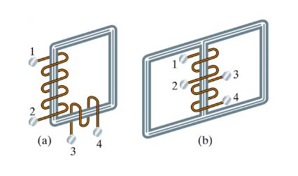

Slide 11
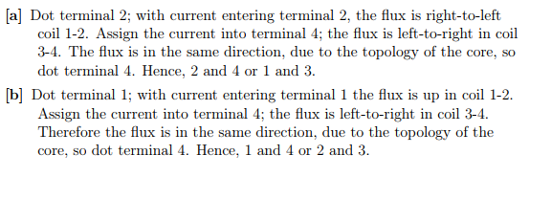

Slide 12
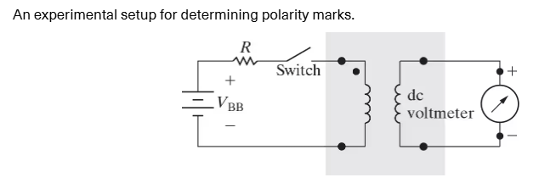

Slide 13
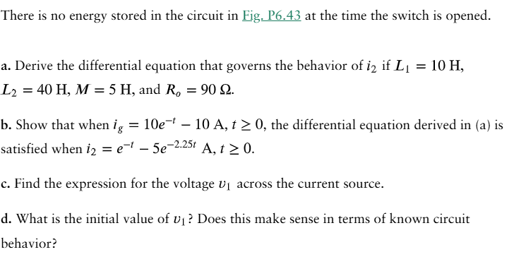
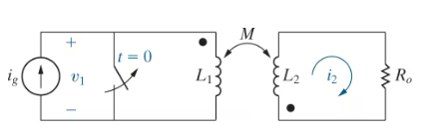

Slide 14
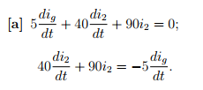
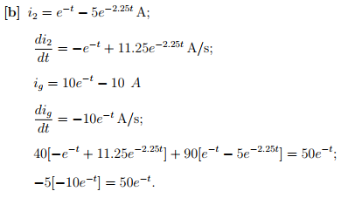

Slide 15
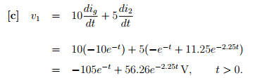
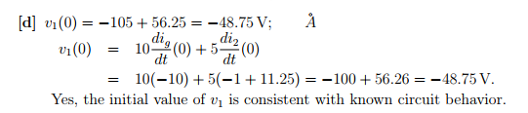

Slide 16
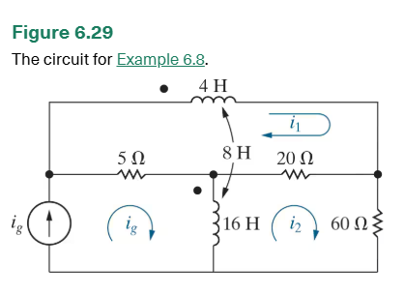

Slide 17
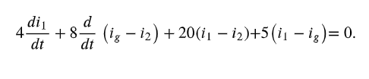


Slide 18




Slide 19


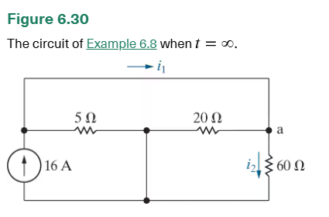



Slide 20
Chapter 6 – Mutual Inductance (8 of 15)
The two equations we just wrote are
A. A coupled system of linear algebraic equations
B. A coupled system of linear integral equations
C. A coupled system of linear differential equations

Slide 21


Chapter 6 – Mutual Inductance (8 of 15)
The two equations we just wrote are
A. A coupled system of linear algebraic equations
B. A coupled system of linear integral equations
C. A coupled system of linear differential equations

Slide 22
Chapter 6 – Mutual Inductance (9 of 15)
We can’t do much in the time-domain with circuits that have mutually-coupled coils, since we can’t easily solve coupled systems of linear differential equations.
We will revisit circuits with mutually-coupled coils once we examine the analysis of circuits with sinusoidal sources, starting in Chapter 9.

Slide 23
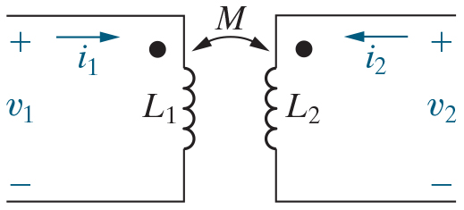


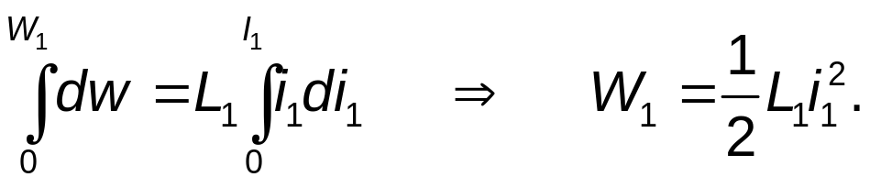
Chapter 6 – Mutual Inductance (10 of 15)
Use the circuit here to calculate the total energy stored in magnetically coupled coils.
Initially, assume both currents and the stored energy are
zero. Then let
increase from 0 to
and calculate the stored
energy:
Notes:
Long Description:
Integral from 0 to uppercase W subscript 1 BaseLine of d lowercase w equals L subscript 1 BaseLine Integral from 0 to uppercase I subscript 1 BaseLine of lowercase i subscript 1 BaseLine d lowercase i subscript 1 BaseLine, Forward arrow, uppercase W subscript 1 BaseLine equals Start Fraction 1 over 2 End Fraction uppercase L subscript 1 BaseLine lowercase i subscript 1 BaseLine squared.

Slide 24




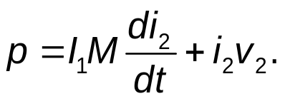

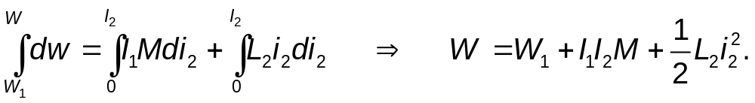
Chapter 6 – Mutual Inductance (11 of 15)
Use the circuit here to calculate the total energy stored in magnetically coupled coils.
Now hold
at
and increase
to
during this increase, the voltage
induced in coil 2 by
is zero because
is constant. The voltage
induced in coil 1 by
is
so the power in the two coils is
The total energy when
reaches
is
Notes:
Long Description:
Integral from W subscript 1 to W of d w equals Integral from 0 to uppercase I subscript 2 BaseLine of uppercase I subscript 1 BaseLine uppercase M d lowercase i subscript 2 BaseLine plus Integral from 0 to uppercase I subscript 2 BaseLine of uppercase L subscript 2 BaseLine lowercase i subscript 2 BaseLine d lowercase i subscript 2 BaseLine, Forward arrow, uppercase W equals uppercase W subscript 1 BaseLine plus uppercase I subscript 1 BaseLine uppercase I subscript 2 BaseLine uppercase M plus Start Fraction 1 over 2 End Fraction uppercase L subscript 2 BaseLine lowercase i subscript 2 BaseLine squared.

Slide 25
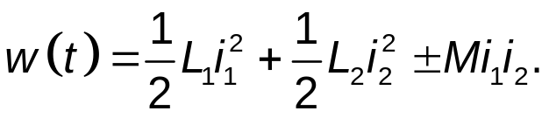
Chapter 6 – Mutual Inductance (12 of 15)
Use the circuit here to calculate the total energy stored in magnetically coupled coils.
Note that in this example, both currents enter the dotted terminals. If one current enters a dotted terminal and the other current leaves, the algebraic sign of the term involving M reverses. Therefore, in general,
Notes:
Long Description:
w Open Parenthesis t Close Parenthesis equals Start Fraction 1 over 2 End Fraction L subscript 1 BaseLine i subscript 1 BaseLine squared plus Start Fraction 1 over 2 End Fraction L subscript 2 BaseLine i subscript 2 BaseLine squared plus or minus M i subscript 1 BaseLine i subscript 2 BaseLine.

Slide 26
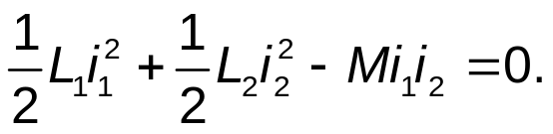

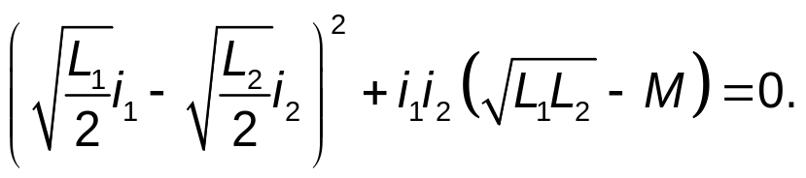
Chapter 6 – Mutual Inductance (13 of 15)
The energy in the magnetically coupled coils can never be negative. From the energy equation, the limiting value of M occurs when
To find the limiting value of M, add and subtract to both sides and simplify to get
Notes:
Long Description 1:
Start Fraction 1 over 2 End Fraction L subscript 1 BaseLine i subscript 1 BaseLine squared plus Start Fraction 1 over 2 End Fraction L subscript 2 BaseLine i subscript 2 BaseLine squared minus M i subscript 1 BaseLine i subscript 2 BaseLine equals 0.
Long Description 2:
Open Parenthesis Start Root Start Fraction L subscript 1 BaseLine over 2 End Fraction End Root i subscript 1 BaseLine minus Start Root Start Fraction L subscript 2 BaseLine over 2 End Fraction End Root i subscript 2 BaseLine Close Parenthesis squared plus i subscript 1 BaseLine i subscript 2 BaseLine Open Parenthesis Start Root L subscript 1 BaseLine L subscript 2 BaseLine End Root minus M Close Parenthesis equals 0.

Slide 27


Chapter 6 – Mutual Inductance (14 of 15)
Use the circuit here to calculate the total energy stored in magnetically coupled coils.
Therefore, the energy in the magnetically coupled coils is positive only if
Thus,

Slide 28



Chapter 6 – Mutual Inductance (15 of 15)
Suppose M = 40 mH,
mH and
mH in a pair of
magnetically coupled coils. What is the coupling coefficient
of the coils, k?
A. 0.8
B.
C. 1.25

Slide 29


Chapter 6 – Mutual Inductance (15 of 15)
Suppose M = 40 mH,
mH and
mH in a pair of
magnetically coupled coils. What is the coupling coefficient
of the coils, k?
A. 0.8
B.
C. 1.25

